Slide 1
SQL Project on Pizza
Presented By:
U. Ananya

Slide 2
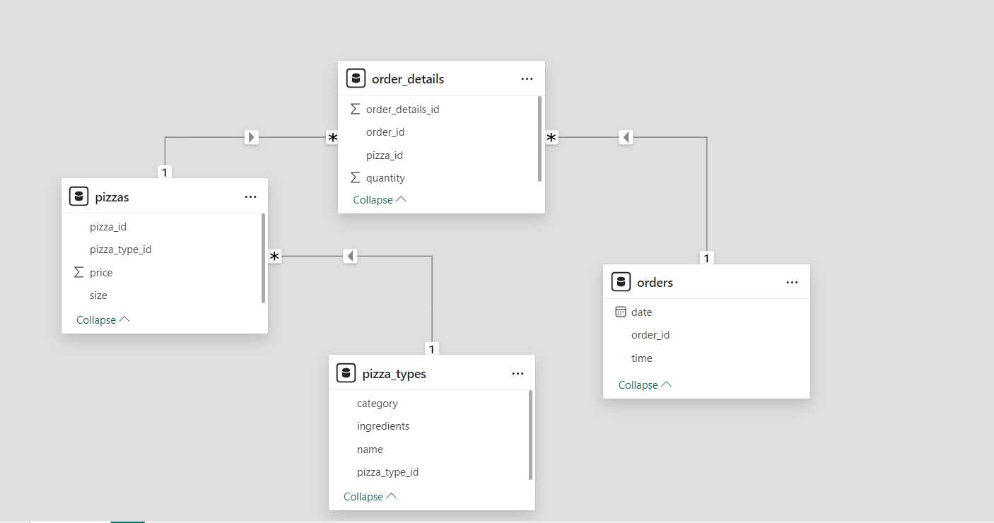
TABLES USED:

Slide 3
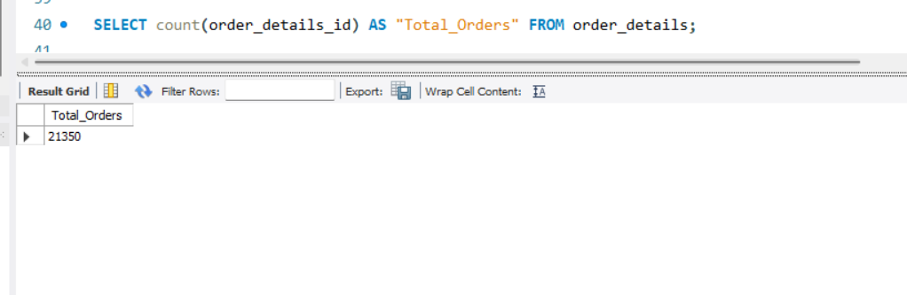
Retrieve the total number of orders placed.

Slide 4
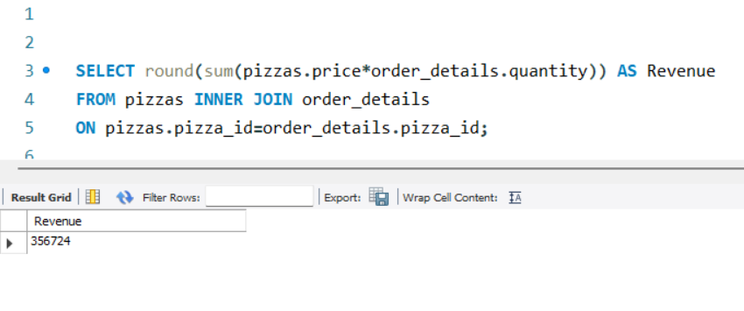
Calculate the total revenue generated from pizza sales.

Slide 5
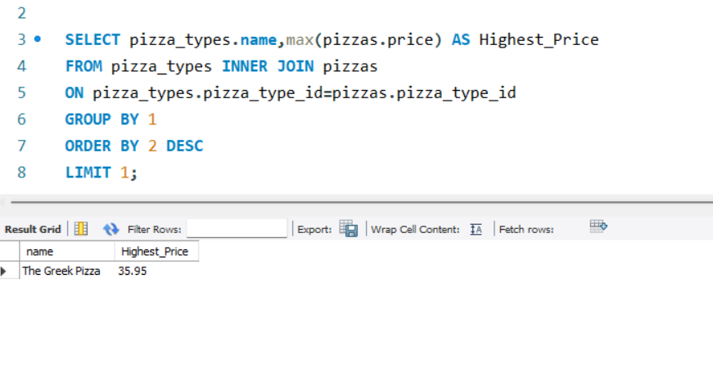
Q: Identify the highest-priced pizza.

Slide 6
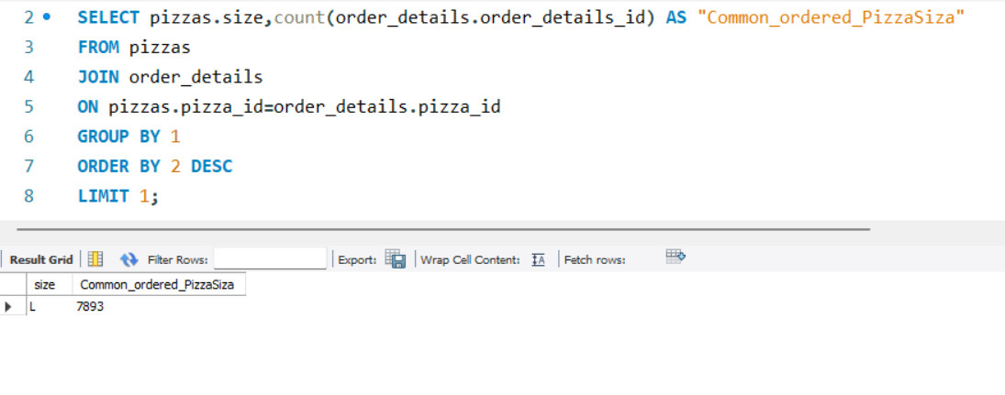
Q: Identify the most common pizza size ordered.

Slide 7
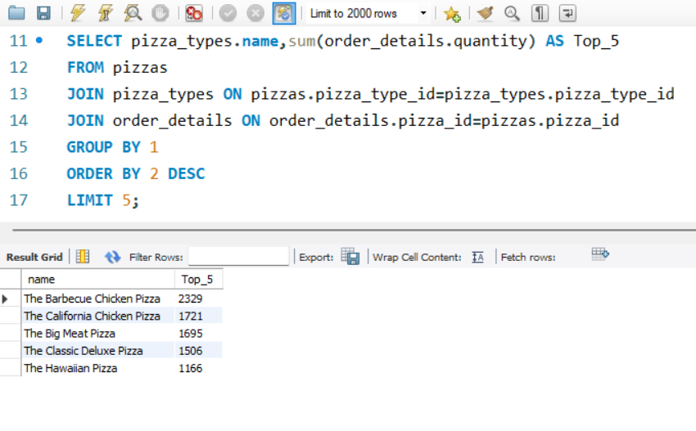
Q: List the top 5 most ordered pizza types along with their quantities.

Slide 8
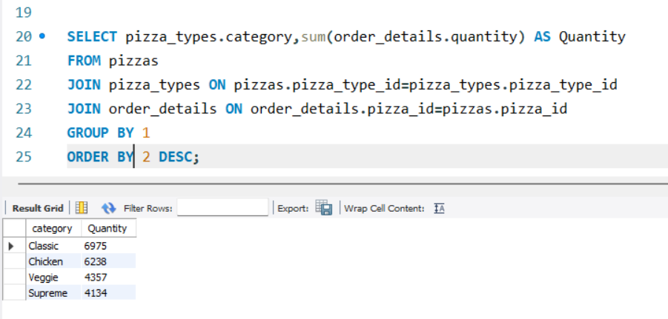
Q: Join the necessary tables to find the total quantity of each pizza category ordered.

Slide 9
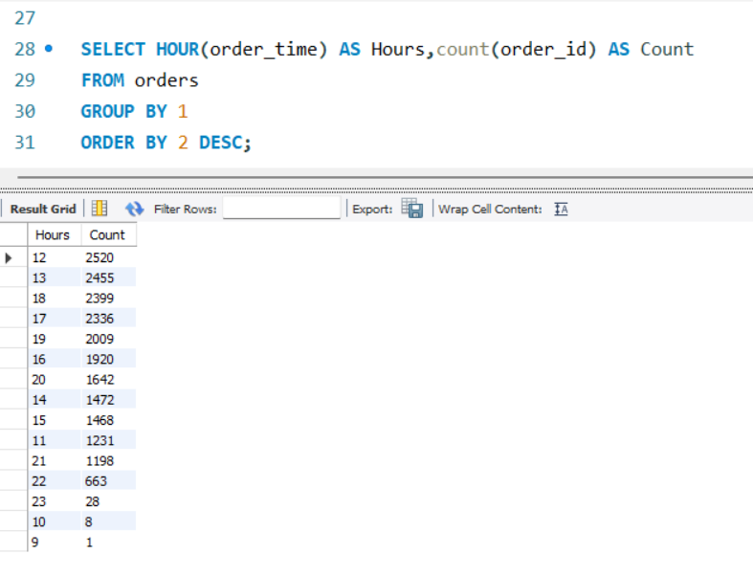
Q: Determine the distribution of orders by hour of the day.

Slide 10
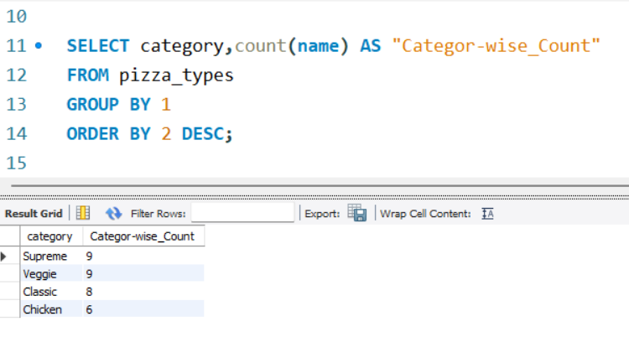
Q: Join relevant tables to find the category-wise distribution of pizzas.
Infographic Style
Get a modern PowerPoint Presentation that is beautifully designed.
Get a modern PowerPoint Presentation that is beautifully designed.
Get a modern PowerPoint Presentation that is beautifully designed.
Get a modern PowerPoint Presentation that is beautifully designed.
Content Here

Slide 11
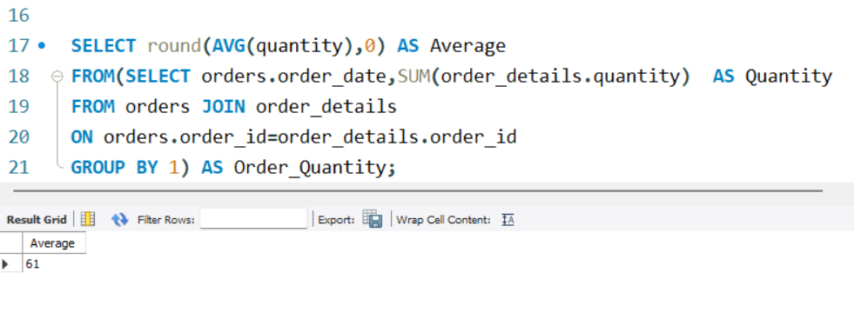
Q: Group the orders by date and calculate the average number of pizzas ordered per day.

Slide 12
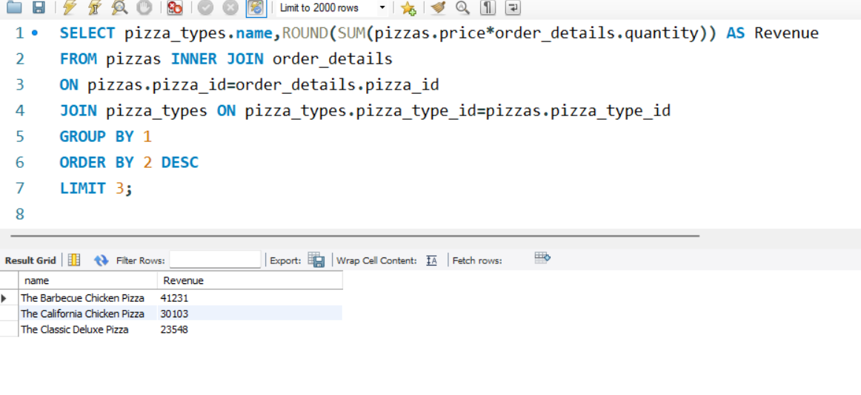
Q: Determine the top 3 most ordered pizza types based on revenue.

Slide 13
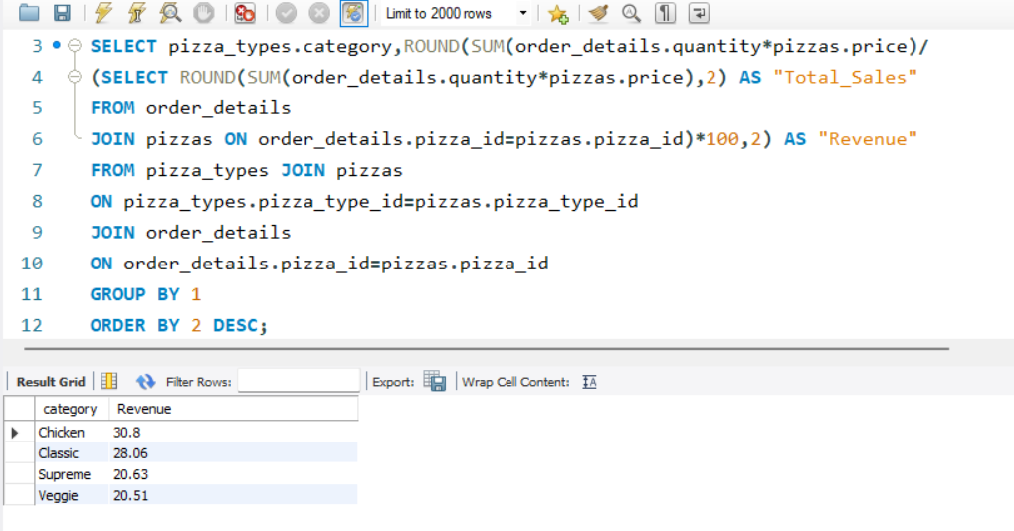
Q: Calculate the percentage contribution of each pizza type to total revenue.
.
.
.
.
.
.
.
.
.
.
.
.
.
.
.
.
.
.
.
.
.
.
.
.
.
.
.

Slide 14
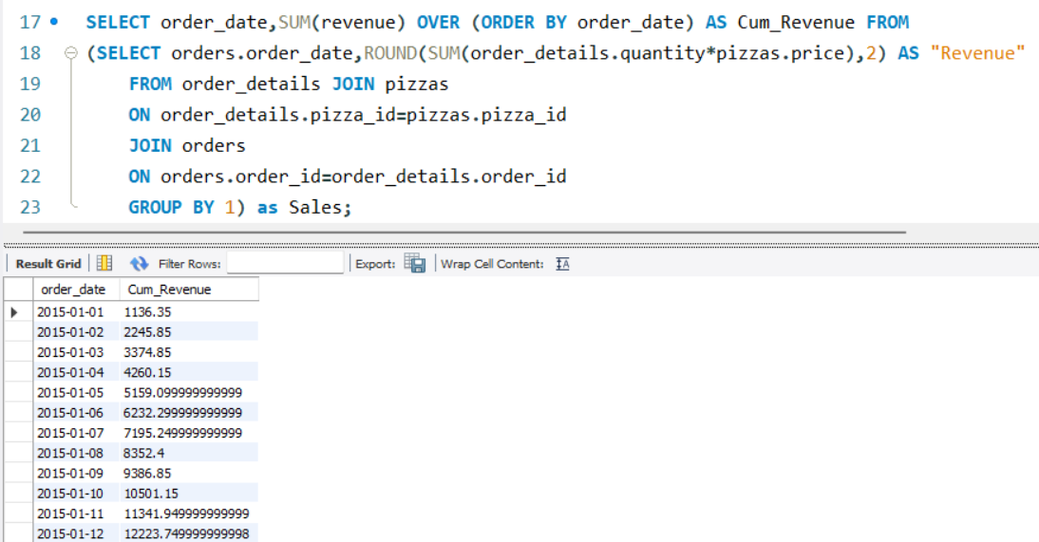
Q: Analyze the cumulative revenue generated over time.
.
.
.
.
.
.
.
.
.
.
.
.
.
.
.
.
.
.
.
.
.
.
.
.
.
.
.

Slide 15
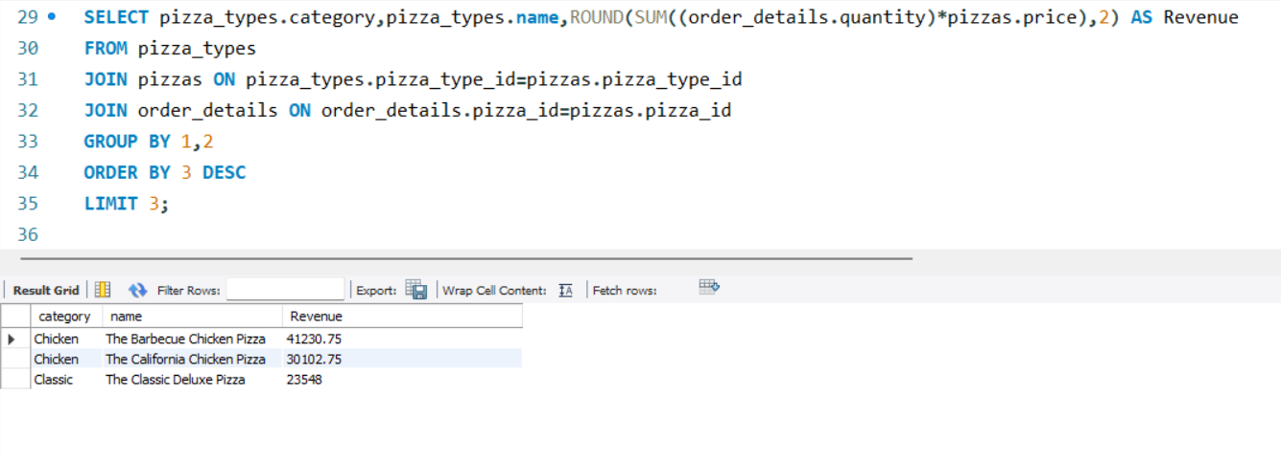
Q: Determine the top 3 most ordered pizza types based on revenue for each pizza category.
.
.
.
.
.
.
.
.
.
.
.
.
.
.
..
.
.
..
.
.
.
.
..

Slide 16
THANK YOU

